Slide 1
HSO Data Quality Framework Rene Nadorp, Daniëlle van Dis, Walter Smetsers

Slide 2

Content
The importance and business case of a Data Quality Framework
The definition of a Data Quality Framework
The vision of HSO on data quality, data governance and data management
The HSO unique approach and services
​

Slide 3

Main ambition and goals
HSO Data Quality
DEFINITION

Slide 4


Data quality definition
Based on two pillars
Data is of high quality, if the data is fit for the intended purpose of use
Data is of high quality, if the data correctly represent
the real-world construct that the data describes

Slide 5
Main ambition and goals
HSO Data Quality
WHY

Slide 6
Data quality definition based on two pillars
Why should you implement a data quality framework?
The perks of implementing a data quality framework
What is a data quality framework?
Data quality framework
What is HSO vision on data quality, data governance and data management?
HSO vision on data quality, data governance and data management
HSO Approach and services

Slide 7

From data to business outcomes
It starts with data quality
BUSINESS OUTCOMES
WISDOM
APPLIED
KNOWLEDGE
DECISION QUALITY
KNOWLEDGE
ACTIONABLE
INFORMATION
INFORMATION QUALITY
INFORMATION
DATA IN
CONTEXT
DATA QUALITY
DATA
Notes:
Source: https://profisee.com/data-quality-what-why-how-who/
"You can regard data as the foundation for a hierarchy where data is the bottom level. On top of data you have information, being data in context. Further up we have knowledge seen at actionable information and on top level wisdom as the applied knowledge. If you have bad data quality, you will not have good information quality. With bad information quality you will lack actionable knowledge in business operations and not be able to apply that knowledge or do that wrongly with risky business outcomes as the result."

Slide 8
The importance of data quality
Poor data quality can result in
Regulatory risk
Investment risk
Privacy risk
Competitive risk
Fraud detection
Increased risk
Increased costs
Increased workloads
Increased process times
System delays
Decreased revenue
Low confidence
Lost opportunities
Increased cost per volume
Customer attrition
Organizational trust issues
Impaired decision-making
Impaired forecasting
Notes:
"Valid data lies at the heart of the strategic, tactical and operational steering of every organization. Having appropriate data quality processes in place directly correlates with an organization’s ability to make the right decisions and assure its economic success. This slide highlights a few of the challenges for data quality in today’s companies:
Employees do not work with their BI applications because they do not trust them (and/or their underlying data)
Incorrect data leads to false facts and bad decisions in data-driven environments
If data quality guidelines are not defined, multiple data copies are generated that can be expensive to clean up
A lack of uniform concepts for data quality leads to inconsistencies and threatens content standards
Stricter compliance requirements make it more important than ever to ensure that data quality standards are met"
Geraadpleegde bronnen:
- https://www.gs1.org/docs/gdsn/support/it/data_quality_business_case.pdf
- https://bi-survey.com/data-quality-master-data-management

Slide 9
Consequences of poor data quality
By the numbers
01
02
03
04
05
$3.1 TRILLION
Businesses in the USA lose $3.1 trillion annually due to poor-quality data.
(IBM)
$15 MILLION
Organizations believe poor data quality to be responsible for an average of $15m per year in losses.
(Gartner)
51% OF THE TIME
The estimated fraction of time that data scientists spend cleaning and organizing data.
(Figure Eight)
20-30% OF EXPENSES
20-30% of operational expenses are directly related to bad data.
(Pragmatic Works)
60% OF ORGANIZATIONS
60% of organizations don’t measure the annual financial cost of poor-quality data.
(Gartner)
Notes:
Sources:
https://www.gartner.com/smarterwithgartner/how-to-create-a-business-case-for-data-quality-improvement
https://www.gartner.com/smarterwithgartner/how-to-stop-data-quality-undermining-your-business
https://hbr.org/2016/09/bad-data-costs-the-u-s-3-trillion-per-year
https://visit.figure-eight.com/rs/416-ZBE-142/images/CrowdFlower_DataScienceReport.pdf
https://www.forbes.com/sites/forbestechcouncil/2021/10/14/flying-blind-how-bad-data-undermines-business/?sh=2e4f56d429e8
https://blog.pragmaticworks.com/the-cost-of-bad-data-infographic

Slide 10
The benefits of data quality
More confidence leads to better decision-making
1
Higher productivity
2
Competitive advantage
3
Ability to act on opportunities
4
Reduced risk
5
Increased revenue
6
Improved customer experience
7
Notes:
Geraadpleegde bronnen:
https://www.pitneybowes.com/content/dam/pitneybowes/us/en/campaign-pages/forbesdata-wp/Forbes-Insights-The-Data-Differentiator-White-Paper-US-External-31May17.pdf
DAMA DMBOK page 28

Slide 11
Main ambition and goals
HSO Data Quality
FRAMEWORK

Slide 12
Framework Components
Business Ownership
Data Quality Dimensions
Data Quality Management Cycle
Data Quality Control Types
Notes:
https://www.sbctc.edu/resources/documents/colleges-staff/commissions-councils/dgc/data-quality-deminsions.pdf

Slide 13

HSO Data Quality Framework
Data Quality Dimensions
Business Ownership
Reasonabilty
Accuracy
Timeliness
Completeness
Data Steward
Domain A
Data Steward
Domain B
Uniqueness
Integrity
Validity
Consistency
Continuous data quality validation & optimization

Slide 14

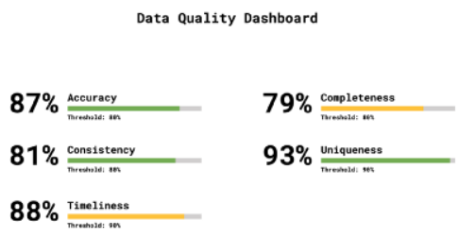



Framework Components
Data Quality Insights
On high level, Data Quality Framework will act as a governance layer connecting the data quality aspects to the business owners
Data has only value with the correct interpretation by the business owners and end-users
The business involvement an iterative process to continuously maintain and improve the quality of data to meet the user’s expectations
The business owner is a subject matter expert, but the amount of data can be overwhelming
Create automated insights in reports and dashboards to help the business owner with the data validation, during the developing phase (validation) and after go live (monitor)!
Business Owner
Data Storage

Slide 15
Main ambition and goals
HSO Data Quality Framework
DATA GOVERNANCE ORGANIZATION

Slide 16


Data Governance Organization, Roles and Responsibilities
Strategic level
Executive Sponsor:
Chief Information Officer (CIO) | Chief Financial Officer (CFO)
A senior business stakeholder with authority and budget who is responsible for data governance
Data Governance Council:
Composed of the data owners and the lead data steward
Manages data governance initiatives (e.g., development of policies or metrics), issues, and escalations
Executive Sponsor
Data Governance Council
Data Owners
Lead Data Steward / Chief Data Officer
Tactical level
Data Owners:
A business Data Steward is someone who has the authority to make decisions about data within their domain
Data Governance Working Group
Data Governance Working Group
Operational level
Data Owners
Data Owners
Data Stewards:
Responsible for the overall data management
Technical Data
Steward(s)
Technical Data
Steward(s)
Technical Data
Steward(s)
Technical Data
Steward(s)
…
…

Slide 17
Main ambition and goals
HSO Data Quality
DIMENSIONS

Slide 18
Data Quality Dimensions
Reasonability
Accuracy
Timeliness
Completeness
Uniqueness
Consistency
Validity
Integrity
Notes:
https://www.sbctc.edu/resources/documents/colleges-staff/commissions-councils/dgc/data-quality-deminsions.pdf

Slide 19
Data Quality Dimensions: Accuracy
Accuracy refers to the degree that data correctly represent ‘real-life’ entities
Most measures of accuracy rely on comparison to a data source that has been verified as accurate
Example:
Incorrect spellings of product or person names, addresses, etc.
Revenue in the dataplatform is exactly the same as in the source system
Reasonabilty
Accuracy
Timeliness
Completeness
Uniqueness
Consistency
Validity
Integrity
Notes:
8 dimensions from DAMA DMBOK
"When improving data quality, the aim will be to measure and improve a range of data quality dimensions."

Slide 20
Data Quality Dimensions: Completeness
Completeness refers to whether all required data is present
Metric:
Compare the overall number of records to the number of records where data is populated
Example:
Postal Code must be populated in the address table
Reasonabilty
Timeliness
Uniqueness
Consistency
Accuracy
Completeness
Integrity
Validity
Notes:
8 dimensions from DAMA DMBOK
"When improving data quality, the aim will be to measure and improve a range of data quality dimensions."

Slide 21
Data Quality Dimensions: Consistency
Consistency refers to whether data values are consistently represented within a data set and between data sets
For example:
An employee's date of birth has the same value and format in two different systems
Reasonabilty
Timeliness
Uniqueness
Consistency
Accuracy
Completeness
Integrity
Validity
Notes:
8 dimensions from DAMA DMBOK
"When improving data quality, the aim will be to measure and improve a range of data quality dimensions."

Slide 22
Data Quality Dimensions: Integrity
Integrity is referred to as:
Referential integrity referring to consistency between data objects via a reference key contained in both objects
Internal consistency within a data set such that there are no missing parts
Reasonabilty
Timeliness
Uniqueness
Consistency
Accuracy
Completeness
Integrity
Validity
Notes:
8 dimensions from DAMA DMBOK
"When improving data quality, the aim will be to measure and improve a range of data quality dimensions."

Slide 23
Data Quality Dimensions: Reasonability
Reasonability asks whether a data pattern meets expectations
Examples:
The distribution of sales across a geographic area is aligned with other characteristics (e.g. population)
YoY difference not higher than 100%
Reasonabilty
Timeliness
Uniqueness
Consistency
Accuracy
Completeness
Integrity
Validity
Notes:
8 dimensions from DAMA DMBOK
"When improving data quality, the aim will be to measure and improve a range of data quality dimensions."

Slide 24
Data Quality Dimensions: Timeliness
There are two elements contributing to this indicator:
Currency:
Measure of whether data values are the most up-to-date version of the information required
Example: address is changed and will be changed in database on day 1 of each month
Volatility:
How frequently data is likely to change and for what reasons
Example: Date of Birth might have zero volatility whilst stock price would have extremely high volatility
Reasonabilty
Timeliness
Uniqueness
Consistency
Accuracy
Completeness
Integrity
Validity
Notes:
8 dimensions from DAMA DMBOK
"When improving data quality, the aim will be to measure and improve a range of data quality dimensions."

Slide 25
Data Quality Dimensions: Uniqueness
Uniqueness states that no entity exists more than once within the data set
Metric:
Count the number of duplicate records identified
Example:
There should be one and only one current row per postal code in the Postal Codes master list
Combination of customer name, address, postal code and number should be unique
Reasonabilty
Timeliness
Uniqueness
Consistency
Accuracy
Completeness
Integrity
Validity
Notes:
8 dimensions from DAMA DMBOK
"When improving data quality, the aim will be to measure and improve a range of data quality dimensions."

Slide 26
Data Quality Dimensions: Validity
Validity refers to whether data values are in accordance with a defined set of rules or values
Metric:
Count the number of records where the set business rule is met
Example:
Age of a human must be between 0 and 500
Company Number is one of {1, 2, 3}
A loan must have at least 1 loan part
Number of employees is between 1 and 1000
Distance between 2 locations cannot be negative
Reasonabilty
Timeliness
Uniqueness
Consistency
Accuracy
Completeness
Integrity
Validity
Notes:
8 dimensions from DAMA DMBOK
"When improving data quality, the aim will be to measure and improve a range of data quality dimensions."

Slide 27
Main ambition and goals
HSO Data Quality
MANAGEMENT CYCLE

Slide 28
Data Quality Management Cycle
'Plan' Stage
'Do' Stage
Do
Check
Act
Plan
A plan is made that includes data quality objectives
Data quality rules and targets are formulated
Data is analyzed to identify the data that does meet the objectives and to identify how issues can be corrected
Data processing is performed to meet data quality objectives
'Act' Stage
'Check' Stage
The root causes of data quality issues are addressed, and solutions are proposed
Rules and targets are adjusted if necessary
Data quality is monitored
Results are compared with the set targets
Results are evaluated and discussed
Notes:
"The best practice process for improving and ensuring high data quality follows the so-called data quality cycle.
The cycle is made up of an iterative process of analyzing, cleansing and monitoring data quality. The concept of a cycle emphasizes that data quality is not a one-time project but an ongoing undertaking."
Bron: DAMA DMBOK

Slide 29
Main ambition and goals
HSO Data Quality
CONTROL TYPES

Slide 30
Data Quality Control Types
Functional
Technical
Interlayer
Intralayer
Row Level
Set Level
Distribution
Trend
Notes:
https://www.sbctc.edu/resources/documents/colleges-staff/commissions-councils/dgc/data-quality-deminsions.pdf

Slide 31
Data Quality Control Types: Functional
Number of employees:
Approximately 300
Revenue:
Approximately 10 mio / year
Sales Order must have at least 1 item
An Opportunity must be linked to a Customer
Functional
Interlayer
Row Level
Set Level
Technical
Intralayer
Trend
Distribution
Notes:
8 dimensions from DAMA DMBOK
"When improving data quality, the aim will be to measure and improve a range of data quality dimensions."

Slide 32
Data Quality Control Types: Technical
Table X cannot be empty
Table X must have a PK
Table X has FK columns {…}
FK column in Table X cannot be empty
FK value in Table X can be found in related Table Y
Column names must follow naming conventions
Role X has only access to data of Company Y
Table X has columns {…}
Table X has data for Customers {...}
Functional
Interlayer
Row Level
Set Level
Technical
Intralayer
Trend
Distribution
Notes:
8 dimensions from DAMA DMBOK
"When improving data quality, the aim will be to measure and improve a range of data quality dimensions."

Slide 33
Data Quality Control Types: Interlayer
Value of Colum X in Table Y in staging layer is the same as Colum A in Table B in DWH layer
Number of records in Table X in staging layer is the same as in Table Y in DWH layer
Hash total of colum X in Table Y in staging layer is the same as colum A in Table B in DWH layer
Functional
Interlayer
Row Level
Set Level
Technical
Intralayer
Trend
Distribution
Notes:
8 dimensions from DAMA DMBOK
"When improving data quality, the aim will be to measure and improve a range of data quality dimensions."

Slide 34
Data Quality Control Types: Intralayer
Number of records in Table X
Total value in Column X in Table Y
Column X in Tabe Y cannot be empty
FK found can be found in related table
Table X contains dummy records
Functional
Interlayer
Row Level
Set Level
Technical
Intralayer
Trend
Distribution
Notes:
8 dimensions from DAMA DMBOK
"When improving data quality, the aim will be to measure and improve a range of data quality dimensions."

Slide 35
Data Quality Control Types: Row Level
Sales Order 123 exists in Table X
If Colum X in Table A has value Z then Column Y in Table A must be NULL
Functional
Interlayer
Row Level
Set Level
Technical
Intralayer
Trend
Distribution
Notes:
8 dimensions from DAMA DMBOK
"When improving data quality, the aim will be to measure and improve a range of data quality dimensions."

Slide 36
Data Quality Control Types: Set Level
Date Table must be populated for years 1900 – 3000
Number of records per company in Table X must be > 1
Functional
Interlayer
Row Level
Set Level
Technical
Intralayer
Trend
Distribution
Notes:
8 dimensions from DAMA DMBOK
"When improving data quality, the aim will be to measure and improve a range of data quality dimensions."

Slide 37
Data Quality Control Types: Distribution
Even distribution of Customers by Segment
Distribution of Opportunities across the country should match the distribution of Sales Regions
Functional
Interlayer
Row Level
Set Level
Technical
Intralayer
Trend
Distribution
Notes:
8 dimensions from DAMA DMBOK
"When improving data quality, the aim will be to measure and improve a range of data quality dimensions."

Slide 38
Data Quality Control Types: Trend
The number of Sales Orders from one period to the next cannot vary more than 50%
Functional
Interlayer
Row Level
Set Level
Technical
Intralayer
Trend
Distribution
Notes:
8 dimensions from DAMA DMBOK
"When improving data quality, the aim will be to measure and improve a range of data quality dimensions."

Slide 39
Main ambition and goals
HSO Data Quality
ARCHITECTURE

Slide 40

Data Quality: Architecture
Dataplatform
Sources
Sources
Staging
Data
Integrated
Data
Dimensional
Data
PBI
Reporting
Metadata
DG
App
Data Quality
Dashboard
Data Quality Results
Data Steward
Data Steward
Notes:
Rejected Data Services: not included because it is advanced, not implemented within HSO, not necessary for the general idea
Data Profiling: not included because not necessary for general idea. Profiling could be used for DQ, e.g. using statistics (sum,avg,mean, max, min, ..)

Slide 41
Data Quality Control: Core Process
SELECT
… AS KEY
, CASE
WHEN … THEN 0
ELSE 1
END AS RESULT
, .. AS ALLOWED_DEVIATION
FROM BASE
LEFT OUTER JOIN REF
ON BASE.KEY = REF.KEY
Any dataset, existing or result of script / SQL
BASE
REF
RESULT
Notes:
https://www.sbctc.edu/resources/documents/colleges-staff/commissions-councils/dgc/data-quality-deminsions.pdf

Slide 42
Data Quality Control: Data Model
Data Quality
Data Quality Metadata
DQ
RUN
DQ
HIERARCHY
DQ
DOMAIN
DQ
DIMENSION
DQ
CONTROL
DQ
TYPE
DQ
RESULT
Notes:
https://www.sbctc.edu/resources/documents/colleges-staff/commissions-councils/dgc/data-quality-deminsions.pdf

Slide 43
Main ambition and goals
HSO Data Quality Framework
HOW TO START?

Slide 44
Initial Data Quality Assessment
Define the goals of the assessment
Identify the data that is most important in the organization and identify business rules
Identify the data to be assessed in the initial assessment
Determine the data quality dimensions to use and assign weights to the dimensions
Define metrics for each data quality dimension
Analyze the data
Review the results and determine if data quality is acceptable or not
Take corrective actions as necessary and define an action plan to prevent future recurrences

Slide 45
Main ambition and goals
COMMON USE CASES

Slide 46

Use Cases
DQ Controls on Source Data, reducing load on source system
Feedback loop for DQ issue management in DG application (e.g. Collibra, …)
Providing validated data to platform consumers
Avoid low quality data being published
DQ Dashboard to monitor DQ improvement, monitor trends
Use DQ in system development life cycle
Compliance with regulation (GDPR, BCBS-239)

Slide 47
Main ambition and goals
POSSIBLE NEXT STEPS

Slide 48
Next Steps
TBD

Slide 49
Main ambition and goals
Data Governance
OPERATING MODELS

Slide 50




Data Governance Operating Models
Business unit
Data Governance Organization
Centralized
Decentralized
Hybrid
The DG council has decision-making authority
Priorities and decisions are company aligned
Data stewards have decision-making authority
Priorities and decisions are business unit aligned
“Best of both worlds”
Top-down decision-making
Bottom-up input from business units
Decision-making is easier
Greater control over standards
Increased bureaucracy
More autonomy
Can be a misalignment between priorities from company and of individual business units
Greater responsiveness and flexibility regarding business needs
Can result in lack of standardization

Slide 51
Operating Model Centralized
Example
Executive Sponsor
Steering Committee
Data Governance Council
Chief Data Steward
Data Owners
Data Stewards
Business Data Stewards
Technical Data Stewards
Business Unit 4
Business Unit 4
Business Unit 4
Business Unit 4
Notes:
Rejected Data Services: not included because it is advanced, not implemented within HSO, not necessary for the general idea
Data Profiling: not included because not necessary for general idea. Profiling could be used for DQ, e.g. using statistics (sum,avg,mean, max, min, ..)

Slide 52
Operating Model Decentralized
Example
Steering Commitee
Data Governance Council Business Unit 1
Data Governance Council Business Unit 2
Data Governance Council Business Unit 3
Business Unit
Data Stewards
Business Unit
Data Stewards
Business Unit
Data Stewards
Notes:
Rejected Data Services: not included because it is advanced, not implemented within HSO, not necessary for the general idea
Data Profiling: not included because not necessary for general idea. Profiling could be used for DQ, e.g. using statistics (sum,avg,mean, max, min, ..)

Slide 53
Main ambition and goals
APPENDICES

Slide 54
Dump bronnen en informatie:
https://profisee.com/data-quality-what-why-how-who/
https://towardsdatascience.com/a-comprehensive-framework-for-data-quality-management-b110a0465e83
https://www.Supply chain without ?lotame.com/why-is-data-quality-important/#:~:text=Improved%20data%20quality%20leads%20to,in%20consistent%20improvements%20in%20results.
https://ec.europa.eu/eurostat/cros/system/files/methodology_for_data_validation_v1.0_rev-2016-06_final.pdf
https://www.toptal.com/database/data-warehouse-data-quality-process

Slide 55
Main ambition and goals
ARCHIVE

Slide 56
Data Quality Management Cycle
Do
Check
Act
Plan
A Data Quality Cycle begins by identifying the data that does not meet data consumers’ requirements and data issues that are obstacles to the achievement of business objectives.
Notes:
"The best practice process for improving and ensuring high data quality follows the so-called data quality cycle.
The cycle is made up of an iterative process of analyzing, cleansing and monitoring data quality. The concept of a cycle emphasizes that data quality is not a one-time project but an ongoing undertaking."
Bron: DAMA DMBOK

Slide 57
Data Quality Management Cycle
Do
Check
Act
Plan
In the Plan stage, the scope, impact, and priority of known issues is assessed, and alternatives to address these issues are evaluated.
Also, a selection is made of data elements for data quality needs to be monitored.

Slide 58
Data Quality Management Cycle
Do
Check
Act
Plan
In the Do stage, the DQ team leads efforts to address the root causes of issues and plan for ongoing monitoring of data.

Slide 59
Data Quality Management Cycle
Do
Check
Act
Plan
The Check stage involves actively monitoring the quality of data as measured against requirements.
If data meets defined thresholds for quality, additional actions are not required.
However, if the data falls below acceptable quality thresholds, then additional action must be taken to bring it up to acceptable levels.

Slide 60
Data Quality Management Cycle
Do
Check
Act
Plan
The Act stage is for activities to address and resolve emerging data quality issues.
The cycle restarts as the causes of issues are assessed and solutions proposed. Continuous improvement is achieved by starting a new cycle. New cycles begin as:
Existing measurements fall below thresholds:
New data sets come under investigation
New data quality requirements emerge for existing data sets
Business rules, standards, are expectations change
Notes:
"To ensure (master) data quality is reached, continuous monitoring and checking of the data is very important. This can be done automatically via software by applying defined business rules. So at the end of the cycle, there is a fluent transition of the original data quality initiative to the second phase: the ongoing protection of data quality."

Slide 61
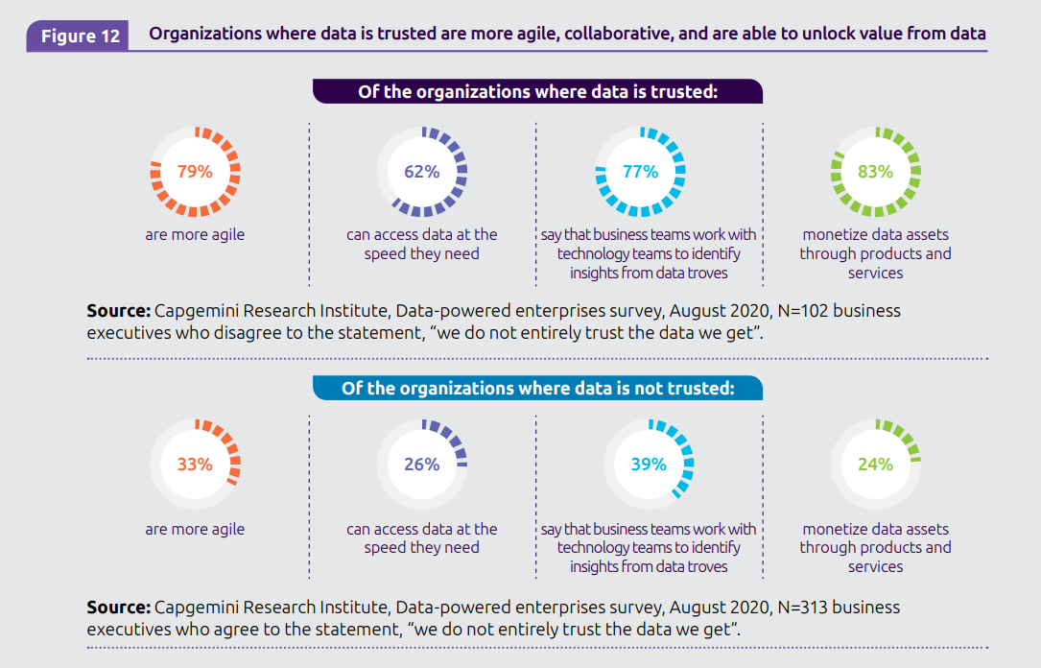
Notes:
Bron: https://www.capgemini.com/wp-content/uploads/2020/11/Data-powered-enterprise_Digital_Report.pdf

Slide 62
Good data quality consequences by the numbers:
62%
Access data they need
20-30% OF EXPENSES
20-30% of operational expenses are directly related to bad data.
(Pragmatic Works)
01
03
05
60% OF ORGANIZATIONS
60% of organizations don’t measure the annual financial cost of poor-quality data.
(Gartner)
79%
More agile
77%
The estimated fraction of time that data scientists spend cleaning and organizing data.
(Figure Eight)
02
04
Notes:
Sources:
https://www.gartner.com/smarterwithgartner/how-to-create-a-business-case-for-data-quality-improvement
https://www.gartner.com/smarterwithgartner/how-to-stop-data-quality-undermining-your-business
https://hbr.org/2016/09/bad-data-costs-the-u-s-3-trillion-per-year
https://visit.figure-eight.com/rs/416-ZBE-142/images/CrowdFlower_DataScienceReport.pdf
https://www.forbes.com/sites/forbestechcouncil/2021/10/14/flying-blind-how-bad-data-undermines-business/?sh=2e4f56d429e8
https://blog.pragmaticworks.com/the-cost-of-bad-data-infographic

Slide 63
Data quality issues
Data quality ranges across a spectrum of issues:
Data-sourcing quality issues (“garbage in, garbage out”)
Technical and business-quality issues (for instance, the definition of a “prospect” could differ in different systems)
Data-veracity issues (accuracy, precision, and trustworthiness of data)
Notes:
Geraadpleegde bronnen:
- https://www.capgemini.com/wp-content/uploads/2021/10/Report-Data-Mastery-web-version.pdf

Slide 64
“Hidden data factory”: the reason why bad data costs so much
Department A completes its work and delivers it to Department B
Department B checks Department A’s work and makes corrections
Department B deals with the consequences of any errors that leaked through
Department B completes its work and delivers it to customers
Visualize the extra steps required to correct costly and time-consuming data errors.
Customers
Notes:
Geraadpleegde bron:
https://hbr.org/2016/09/bad-data-costs-the-u-s-3-trillion-per-year

Slide 65
“Hidden data factory”
Custom manual accommodations for bad data (wasteful workflow)
Corrections are not being standardized or implemented into operations (missed opportunity to correct data at the source)
It is not validated whether the corrections are appropriate with subject matter experts in operations (potential to unknowingly exacerbate inaccuracies)
Notes:
Geraadpleegde bron:
- https://www.kellerschroeder.com/news/2020/06/your-hidden-data-factories-are-costing-you-money/

Slide 66
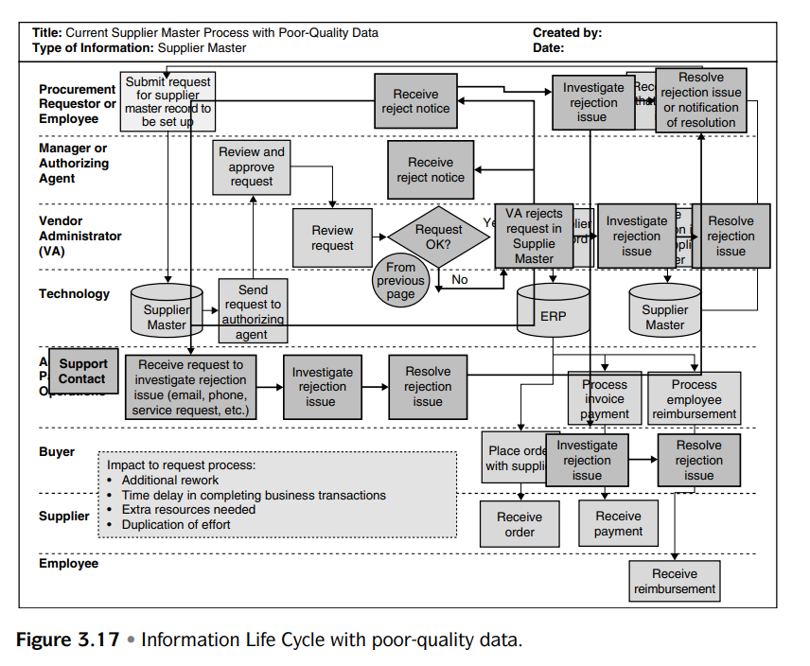
Notes:
Bron: Data Quality Projects Ten Steps to Quality Data and Trusted Information – Danette McGilvray

Slide 67
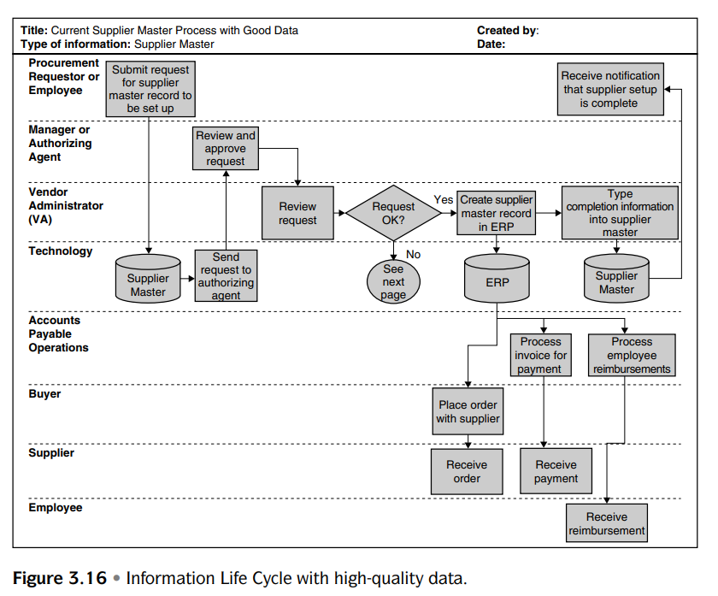
Notes:
Bron: Data Quality Projects Ten Steps to Quality Data and Trusted Information – Danette McGilvray

Slide 68
Ideas:
Checklist for working process and validations during developing
Joining/merge (Merge table A with table B, are records after merge still plausible and logical?)
Standard data cleansing and outlier detection
At start of a project: read data into Azure ML and see which outliers and records are suspicious?
Set up and implement data validation framework
Software tool???
Monitor data quality framework metrics in Power BI
5 dimensions

Slide 69
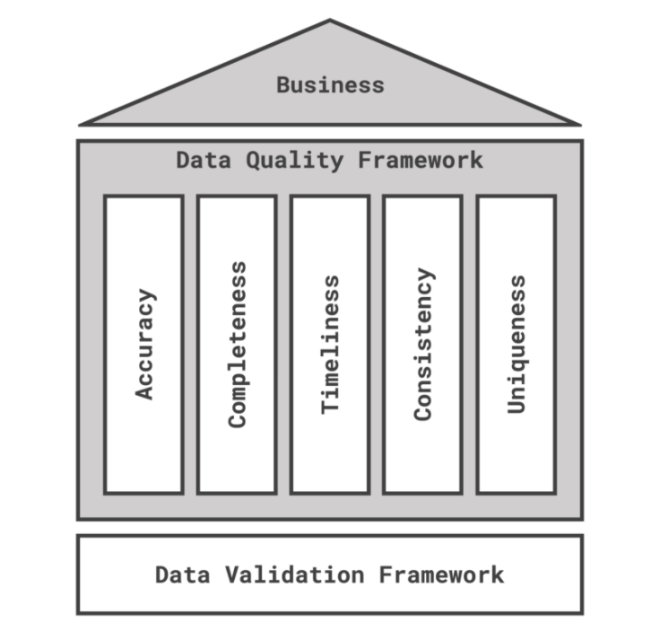
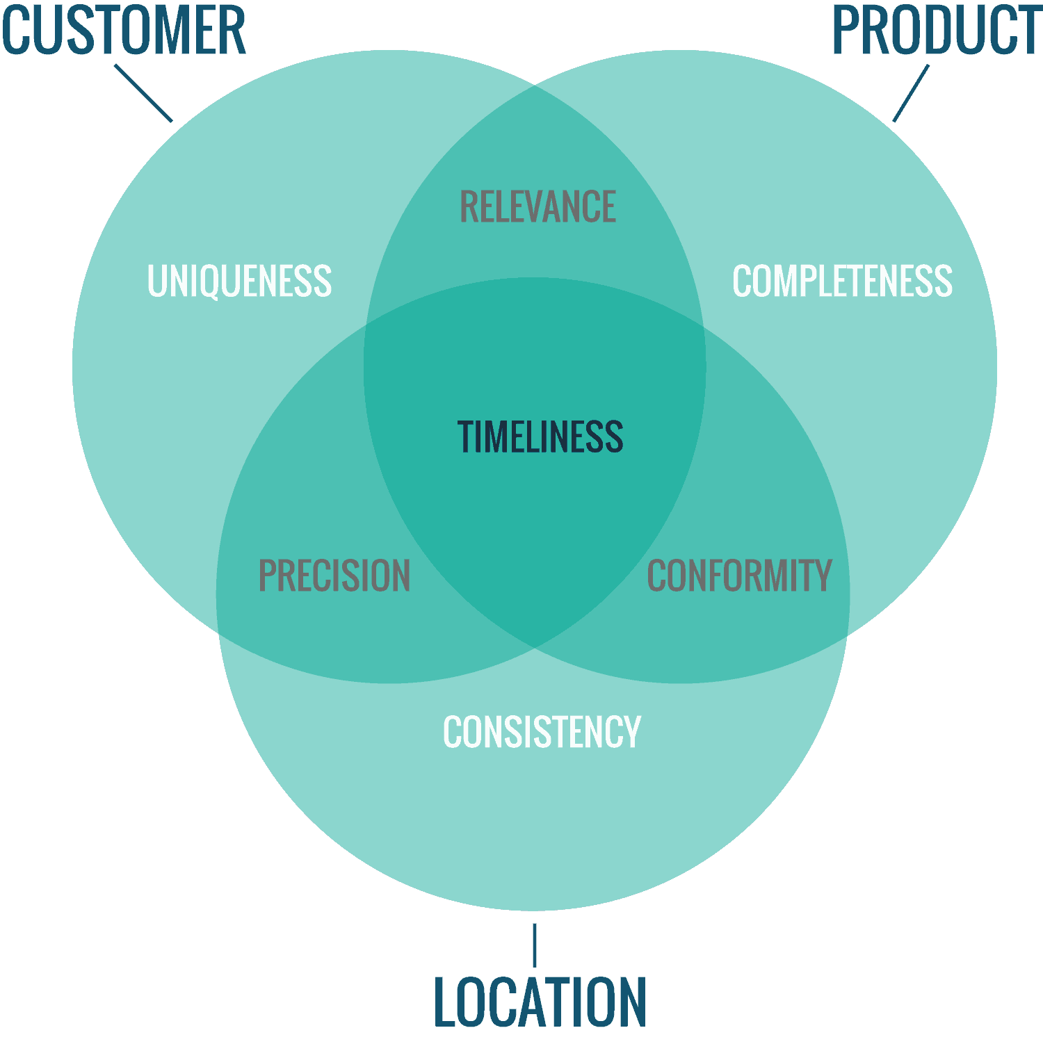
Data quality: 5 dimensions
?
?

Slide 70
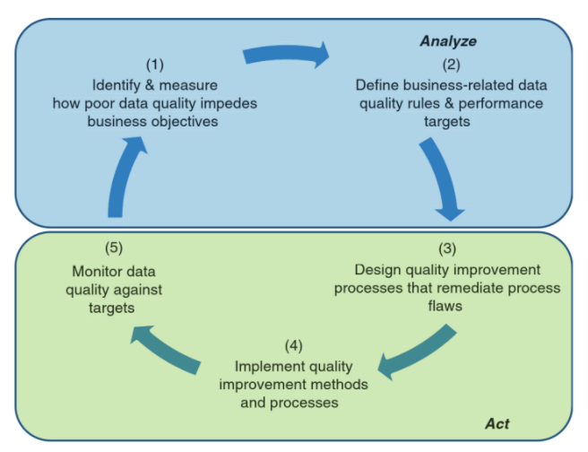
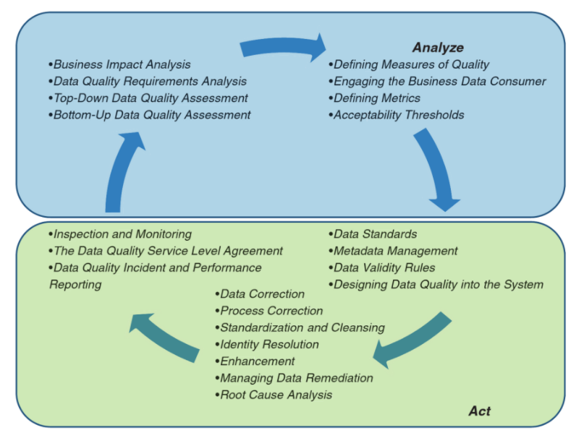
The Virtuous Cycle of Data Quality
Notes:
Bron: a practitioner's guide to data quality improvement

Slide 71
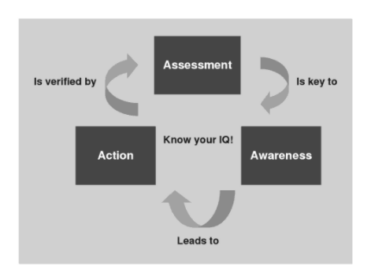
Modification of the “Plan-Do-Check-Act” approach
Assesment (looking at your actual environment and data and comparing them to requirements and expectations)
is key to
Awareness (understanding the true state of your data and information, impact on the business and root causes)
which leads to
Action (prevention of future information and data quality problems in addition to correction of current data errors)
which is verified by
Periodic assessments. And so the cycle continues.
Notes:
Geraadpleegde bronnen:
https://books.google.nl/books?id=55Af6R1I5RMC&printsec=frontcover&dq=ten+steps+to+quality+data&hl=nl&sa=X&redir_esc=y#v=onepage&q&f=false
https://books.google.nl/books?id=peT7DwAAQBAJ&pg=PA90&dq=Executing+Data+Quality+Projects:+Ten+Steps+to+Quality+Data+and+Trusted+Information+(TM)&hl=nl&sa=X&ved=2ahUKEwiAmZKwl7v2AhXYuKQKHecsAa4QuwV6BAgJEAk#v=onepage&q=Executing%20Data%20Quality%20Projects%3A%20Ten%20Steps%20to%20Quality%20Data%20and%20Trusted%20Information%20(TM)&f=false

Slide 72
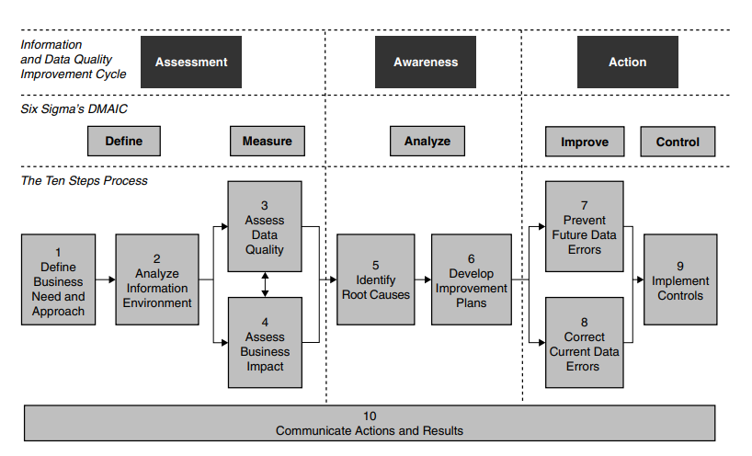
Define: define the problem
Measure: gather data to validate and quantify the problem or opportunity
Analyze: analyze details, enhance, understanding of the problem, and find root cause
Improve: implement solutions
Control: measure and monitor results
Notes:
Geraadpleegde bronnen:
https://books.google.nl/books?id=55Af6R1I5RMC&printsec=frontcover&dq=ten+steps+to+quality+data&hl=nl&sa=X&redir_esc=y#v=onepage&q&f=false
https://books.google.nl/books?id=peT7DwAAQBAJ&pg=PA90&dq=Executing+Data+Quality+Projects:+Ten+Steps+to+Quality+Data+and+Trusted+Information+(TM)&hl=nl&sa=X&ved=2ahUKEwiAmZKwl7v2AhXYuKQKHecsAa4QuwV6BAgJEAk#v=onepage&q=Executing%20Data%20Quality%20Projects%3A%20Ten%20Steps%20to%20Quality%20Data%20and%20Trusted%20Information%20(TM)&f=false

Slide 73
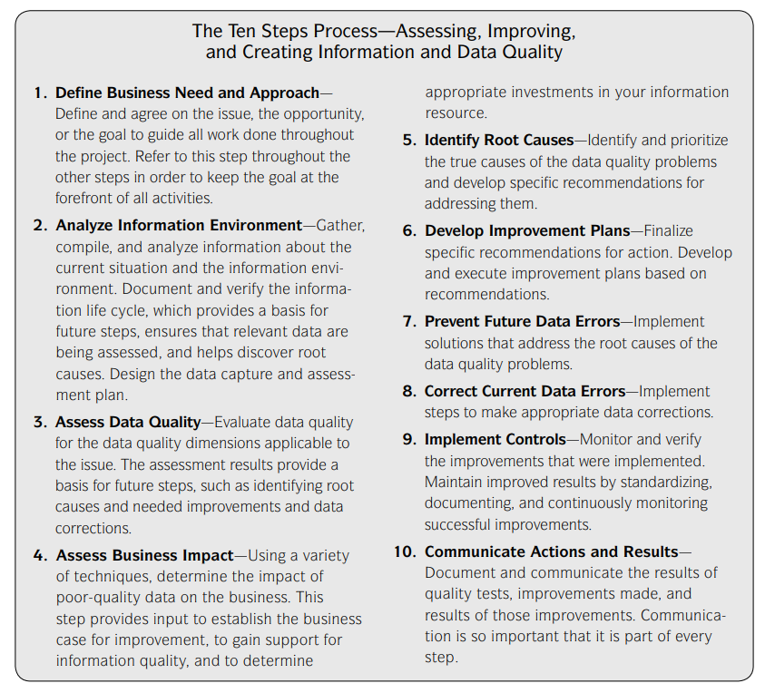
Notes:
Geraadpleegde bronnen:
https://books.google.nl/books?id=55Af6R1I5RMC&printsec=frontcover&dq=ten+steps+to+quality+data&hl=nl&sa=X&redir_esc=y#v=onepage&q&f=false
https://books.google.nl/books?id=peT7DwAAQBAJ&pg=PA90&dq=Executing+Data+Quality+Projects:+Ten+Steps+to+Quality+Data+and+Trusted+Information+(TM)&hl=nl&sa=X&ved=2ahUKEwiAmZKwl7v2AhXYuKQKHecsAa4QuwV6BAgJEAk#v=onepage&q=Executing%20Data%20Quality%20Projects%3A%20Ten%20Steps%20to%20Quality%20Data%20and%20Trusted%20Information%20(TM)&f=false

Slide 74

Continues data quality validation & optimization
Ensuring data quality can be represented as a continuous process:
Control
Define
Measure
Analyze
Improve

Slide 75

Continuous data quality improvement
Define:
Data quality starts with identifying how poor data quality impedes business objectives
Furthermore, data quality expectations are identified
Control
Define
Measure
Analyze
Improve

Slide 76

Continues data quality validation & optimization
Measure:
Measures of quality and metrics will be defined, as well as acceptability thresholds
Control
Define
Measure
Analyze
Improve

Slide 77

Continues data quality validation & optimization
Analyze
Data quality measures
Data quality source data
Data quality data processing
Errors during data processing
Root cause analysis
Report
Report and communicate data quality status and issues
Control
Define
Measure
Analyze
Improve

Slide 78

Continues data quality validation & optimization
Improve:
Correct and handle data quality issues in source (no work a rounds)
Improve error handling (when needed)
Improve data quality detection (when needed)
Control
Define
Measure
Analyze
Improve

Slide 79

Continues data quality validation & optimization
Monitor & Report
This can take many different forms:
Alerting when the process has been halted
Add DQ metadata to reports
Develop specialized DQ reports for use by data administrators
Develop a DQ dashboard for business owners
Control
Define
Measure
Analyse
Improve

Slide 80
Continues data quality validation & optimization
1. Identify
2. Check
3. Error handling
4. Log & describe
5. Report
6. Follow up
1. Identify (data profiling)
Maintaining and improving data quality starts with getting to know the source data.
With analyzing the content, consistency and structure of the (source) data, identifying and understanding the anomalies it contains, and assessing a baseline for “normal” data.

Slide 81
Continues data quality validation & optimization
1. Identify
2. Check
3. Error handling
4. Log & describe
5. Report
6. Follow up
2. Check
The data warehouse / lake production process should check for the occurrence of the identified data quality issues.
Check data quality and business logics together with business owners' data analysts

Slide 82
Continues data quality validation & optimization
3. Error handling
When errors and data quality issues are detected action is needed.
The type of action to be taken depends on the type and severity of the error:
halt the process
send erroneous record to suspend file
tag the erroneous data and pass it on
replace the erroneous data by reasonable defaults/approximations, tag it and pass it on
Determination of the correct action is part of the solution development process in relation to the data driven architecture
1. Identify
2. Check
3. Error handling
4. Log & describe
5. Report
6. Follow up

Slide 83
Continues data quality validation & optimization
1. Identify
2. Check
3. Error handling
4. Log & describe
5. Report
6. Follow up
4. Log & describe:
The result of the executed quality screens and the actions that were taken upon them, is logged.

Slide 84
Continues data quality validation & optimization
1. Identify
2. Check
3. Error handling
4. Log & describe
5. Report
6. Follow up
5. Report
The stakeholders have to be informed about the quality of the data inside the data lake / warehouse. This can take many different forms:
alerting when the process has been halted
add DQ metadata to reports
develop specialized DQ reports, intended for use by administrators
develop a DQ dashboard

Slide 85
Continues data quality validation & optimization
6. Follow up
So far in the process, all steps have been directed at measuring data quality. Though this in itself may be enough on some occasions, usually we will want to improve data quality too, once we become aware of existing issues.
Follow-up actions can be initiated directly after identification (data profiling), or based on DQ results that were reported by the system.
New, previously unknown data problems can also lead to implementation of new screens and error handling measures.
1. Identify
2. Check
3. Error handling
4. Log & describe
5. Report
6. Follow up

Slide 86
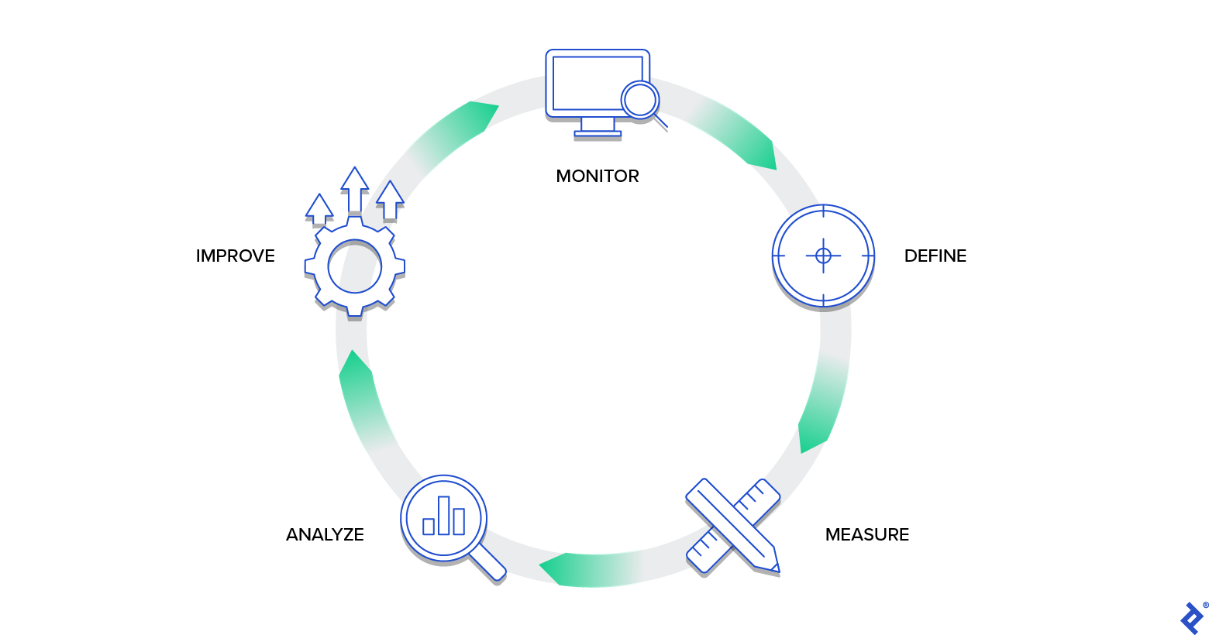

Slide 87
Kapstokjes: in welke fase welke vormen van quality checks?
Project development phase
Validation phase before go live (data validation framework)
Monitoring after go live

Slide 88
Why should you implement a data quality framework?

Slide 89
Braindump René
Uitbreidbaarheid / Aanpasbaarheid vh raamwerk
DQC tbv SDLC: bijv tbv systeemtest
Feedback loop:
DQ Issues terugkoppelen naar een data management oplossing, waarin issues aan data stewards worden toegewezen, die ervoor moeten zorgen dat het issue wordt opgelost
DQ Dashboard: voorbeeld?
DQC’s van brondata vs DQC van data binnen het dwh
DQC: row vs set level (bijv. Distribution controls)
AI tbv DQC?
Functioneel vs technische controles
Hoe ziet volgens HSO een DM organisatie eruit:
Data Stewards
Data Owners
CDO
DQC met bandbreedte
DQ Architectuur: procesplaat en toolset.

Slide 91
Why should you implement a data quality framework?

